Slide 1





SWE3028-Fall-2024
Capstone Design Project
NLP-based
Psychological Diagnostic Diary
Weekly Progress Meeting (1)
런닝머신 팀(TEAM C)
김나영 김예담 박준현 방기호

Slide 2


CONTENTS
01
Technical Background
02
Progress
⓵ UX/UI Design ⓶ Front-end ⓷ AI ⓸ Back-end
03
Challenging Problem
04
Plan
Capstone Design Project

Slide 3
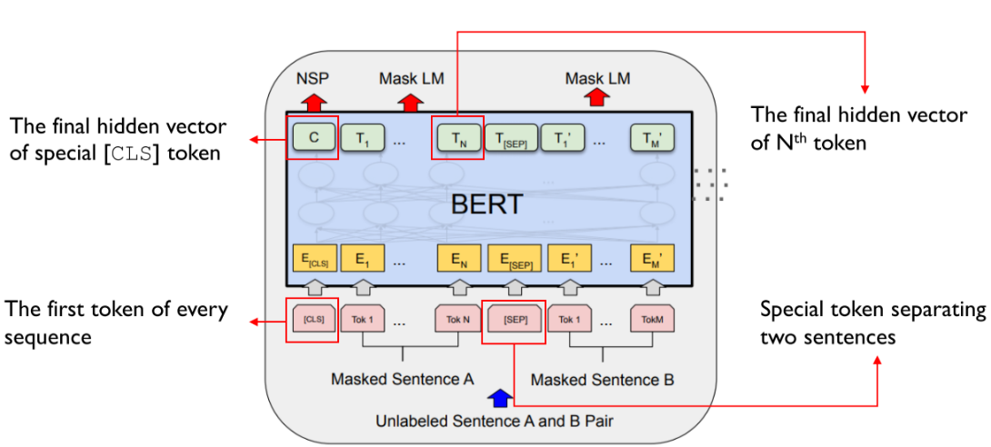


01. Technical Background - BERT
A stack of Transformer Encoders
Working with fine-tuned BERT
Capstone Design Project

Slide 4


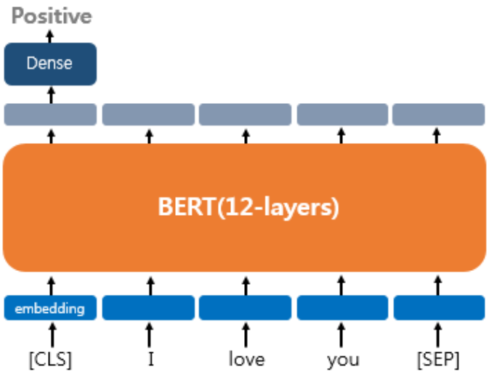

01. Technical Background - BERT
Fine-Tuning
Improve performance
in diverse downstream tasks
Single Text Classification
Capstone Design Project

Slide 5

01. Technical Background - BERT
<limitation>
Capstone Design Project

Slide 6
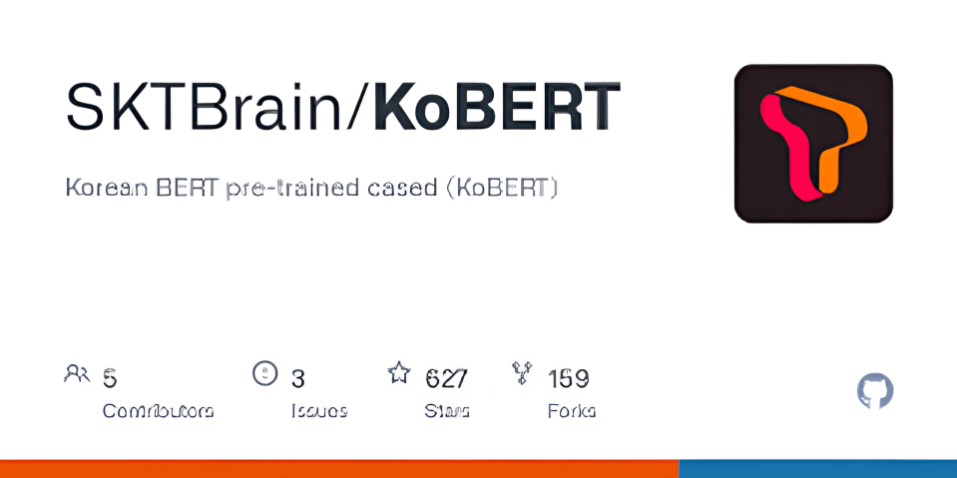

01. Technical Background - KoBERT
A version of BERT fine-tuned for Korean
Capstone Design Project

Slide 7


01. Technical Background - KoBERT
input: 오늘 하루는 정말 힘들었지만 그래도 기분이 나쁘지 않았다.
[CLS] 오늘 하루는 정말 힘들었지만 그래도 기분이 나쁘지 않았다 [SEP]
1. Wordpiece Embedding: The input sentences are tokenized and divided into subwords.
[CLS] 오늘 하루 ##는 정말 힘 들 ##었 ##지만 그래도 기분 ##이 나쁘 ##지 않 ##았 ##다 [SEP]
→ This allows the model to partially handle not only frequently appearing words
but also first-time complex words.
Capstone Design Project

Slide 8


01. Technical Background - KoBERT
[CLS] 오늘 하루 ##는 정말 힘 들 ##었 ##지만 그래도 기분 ##이 나쁘 ##지 않 ##았 ##다 [SEP]
2. Position Embedding: Information about how the tokens are arranged
within the sentence is added.
→ It plays an important role in grasping the context.
3. Segment Embedding: Different sentences are distinguished.
→ It recognizes the differences between sentences by distinguishing several sentences.
Capstone Design Project

Slide 9



01. Technical Background - KoBERT
4. KoBERT - 12 Transformer layers
Each layer learns how a particular word relates to another word in a sentence
through a self-attention.
→ The [CLS] token is transformed into a vector
that reflects the full context of multiple input sentences.
Capstone Design Project

Slide 10

01. Technical Background - KoBERT
[CLS]
5. Dense layer: It selects the final emotion by transforming the vector from the [CLS] token.
① Linear Transformation: transforms dimensions by applying weights and biases
according to the number of emotion labels.
② Softmax: The probability for each emotion class is calculated
and predicted as the emotion with the highest probability value.
Capstone Design Project

Slide 11



01. Technical Background
Why?
BERT
Bidirectional to understand context
back and forth
KoBERT
Optimized for Korean
reflecting irregular language changes in Korean
Capstone Design Project

Slide 12











02. Progess - Expected Progess
Week 2-3 | Week 4-5 | Week 6-7 | Week 8-9 | Week 10-11 | Week 12-13 | Week 14-15
Topic Ideation
Data Collection
AI Model Design
Data PreProcessing
Model & Algorithm Implementation
UX/UI Design & Implementation
Beta Service & FeedBack
Capstone Design Project

Slide 13

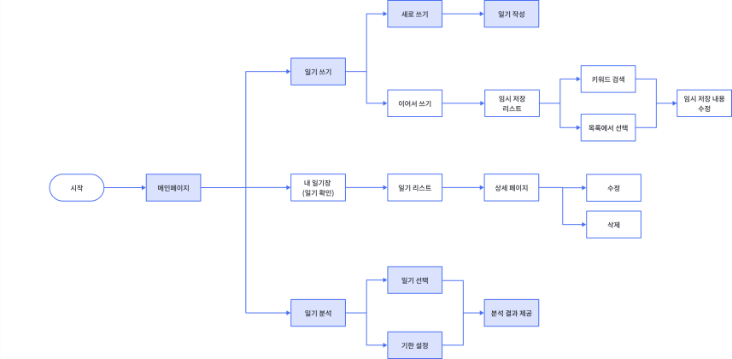
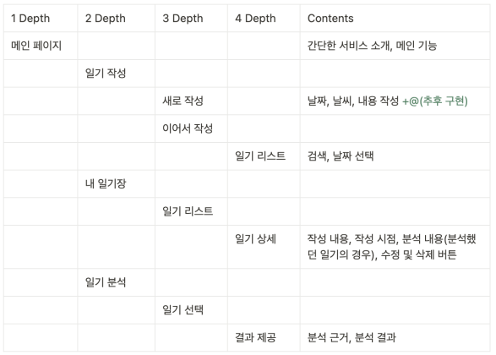
02. Progress - UX / UI Design
Flow Chart
IA
Capstone Design Project

Slide 14

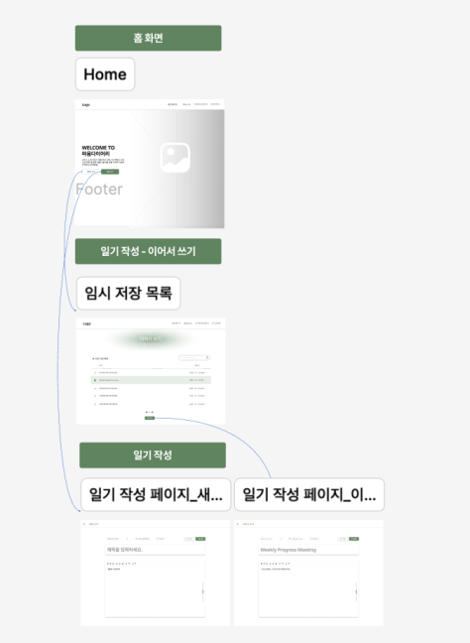
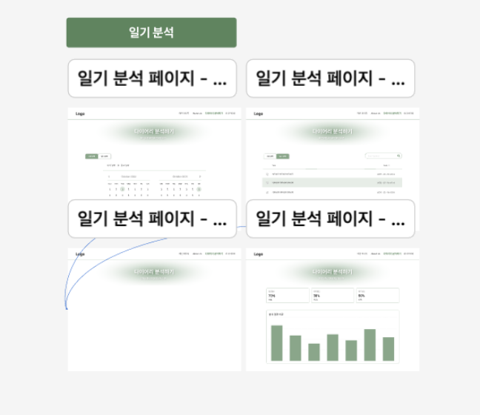
02. Progress - UX / UI Design
Wireframe
Capstone Design Project

Slide 15
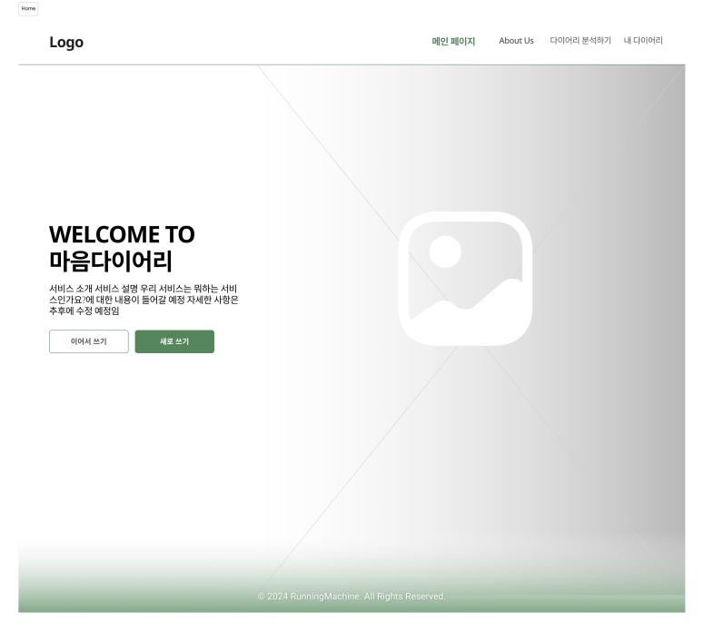
02. Progress - UX / UI Design
<Main Page>
Navigation Bar
Button to Writing Page
Capstone Design Project

Slide 16
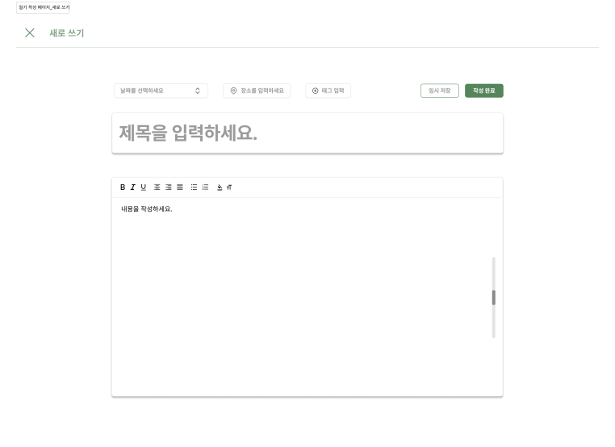
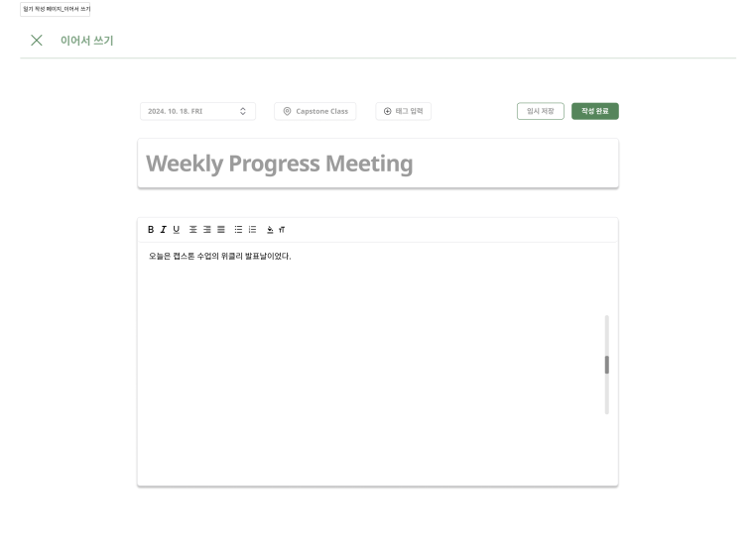
02. Progress - UX / UI Design
<Writing Page>
Create New Journal
Use Drafted Journal
Capstone Design Project

Slide 17
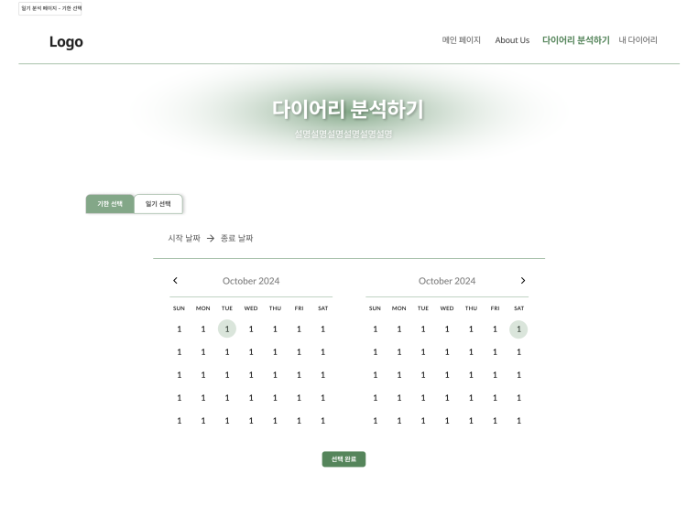
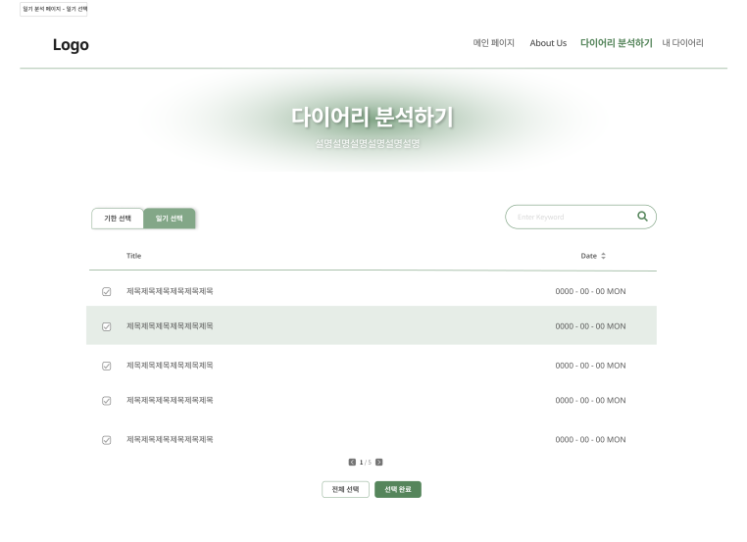
02. Progress - UX / UI Design
<Analyzing Page>
Choosing by Date
Choosing Manually
Capstone Design Project

Slide 18
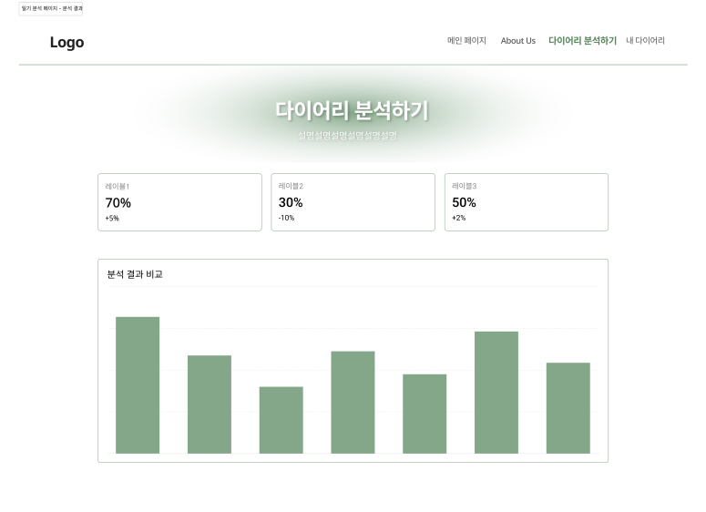
02. Progress - UX / UI Design
<Analyzing Page>
Capstone Design Project

Slide 19
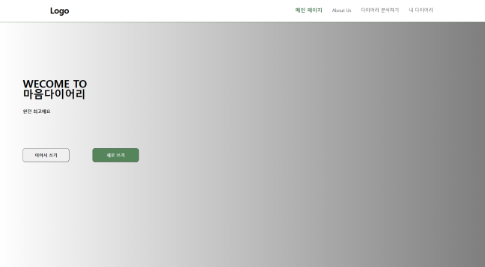

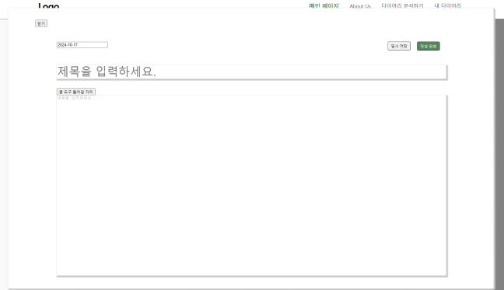
02. Progress - Front-end
Prepare a Framework
Implement Several Pages
Capstone Design Project

Slide 20



02. Progress - AI
Data Collection
Wellness Conversation Script Dataset
From 16,000 counsel data received from Gangnam Severance,
5,232 user utterances were extracted
when the patient himself/herself visited the hospital.
Depression / Sadness / Loneliness / Anger / Lethargy / Abnormal Emotional Control
Sense of Loss / Loss of Appetite / Increase in Appetite / Insomnia
Nervousness / Fatigue / Feeling of Guilt / Loss of Concentration
Decrease in Confidence / Decline in Self-esteem
Feeling of Despair / Suicidal Impulse / Feeling of Insecurity
19 emotional labels in total
Capstone Design Project

Slide 21

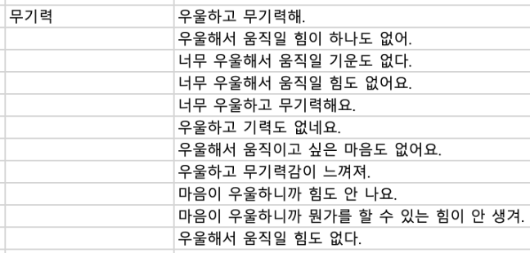
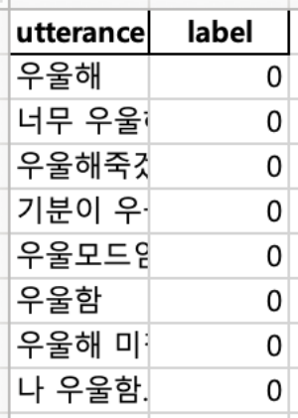
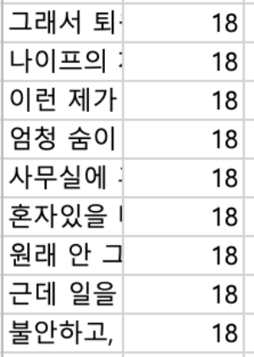
02. Progress - AI
Data Preprocessing
Before
After
Utterances separated
by clinical keywords
Numbered emotion label
tagged for each utterance
Capstone Design Project

Slide 22

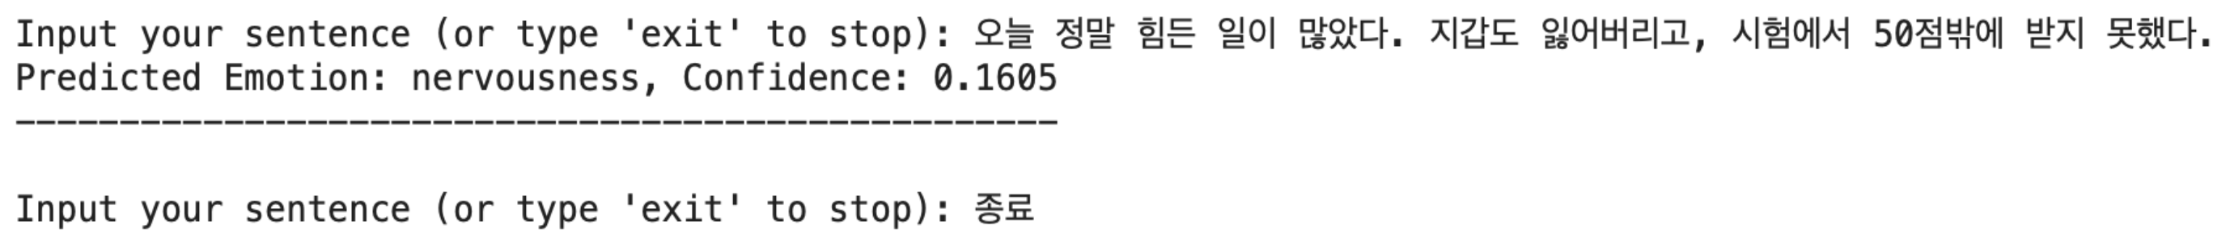

02. Progress - AI
Pipeline Constructing
A baseline pipeline was constructed
using pre-trained KoBERT models provided by SKT Brain.
The above is the result of testing with the built simple emotion classifier.
(https://github.com/SKTBrain/KoBERT)
Capstone Design Project

Slide 23



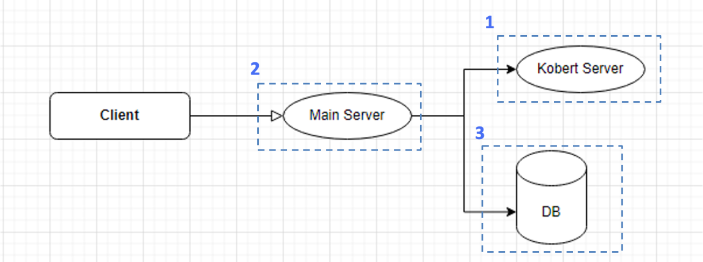

02. Progress - Back-end
Architecture
Input diary data using KoBERT,
emotional data extracted from the text
is output to the server.
A server that performs major functions
- Sending diary data to a kobert server
- Storing and reading this data in a database.
Storage that stores
user information, diary data, etc.
Capstone Design Project

Slide 24

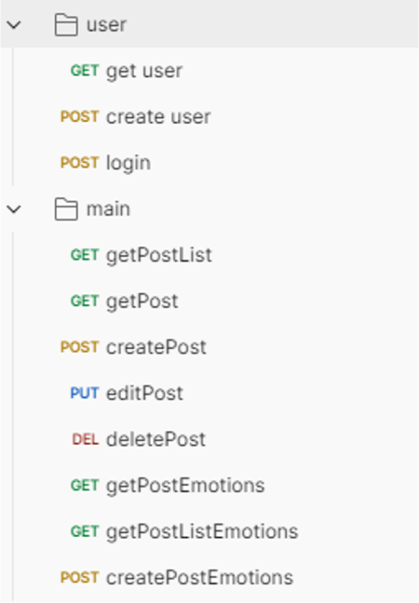
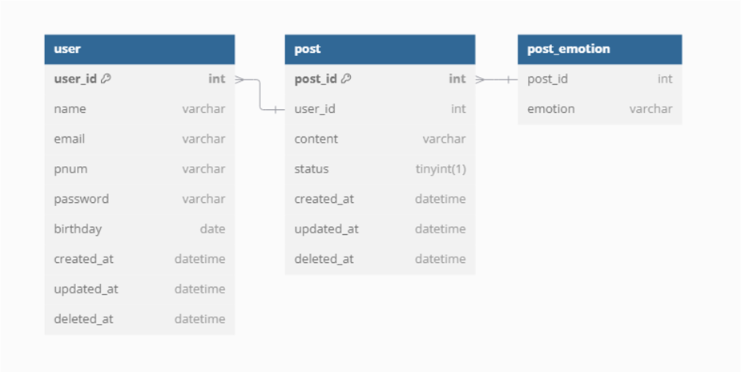
02. Progress - Back-end
API List
ERD
Capstone Design Project

Slide 25

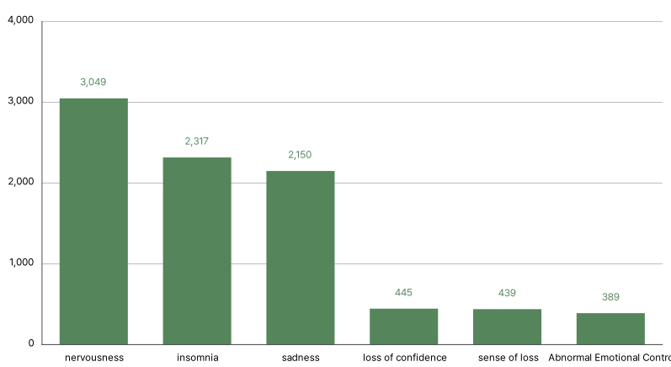

03. Challenging Problem
Optimize Performance
Data Augmentation
Imbalance in the number
of utterances by emotion label
Capstone Design Project

Slide 26
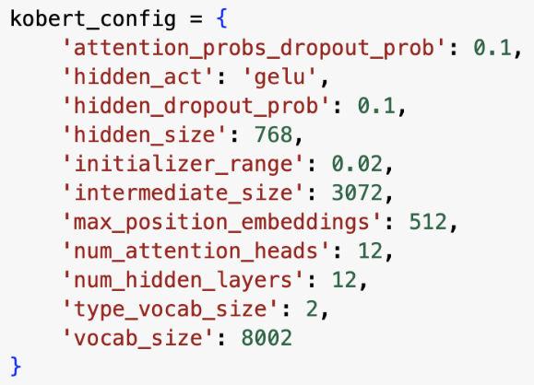
03. Challenging Problem
Hyperparameter Tuning
Plan to use various deep learning techniques
to find the best combination of parameters
Capstone Design Project

Slide 27
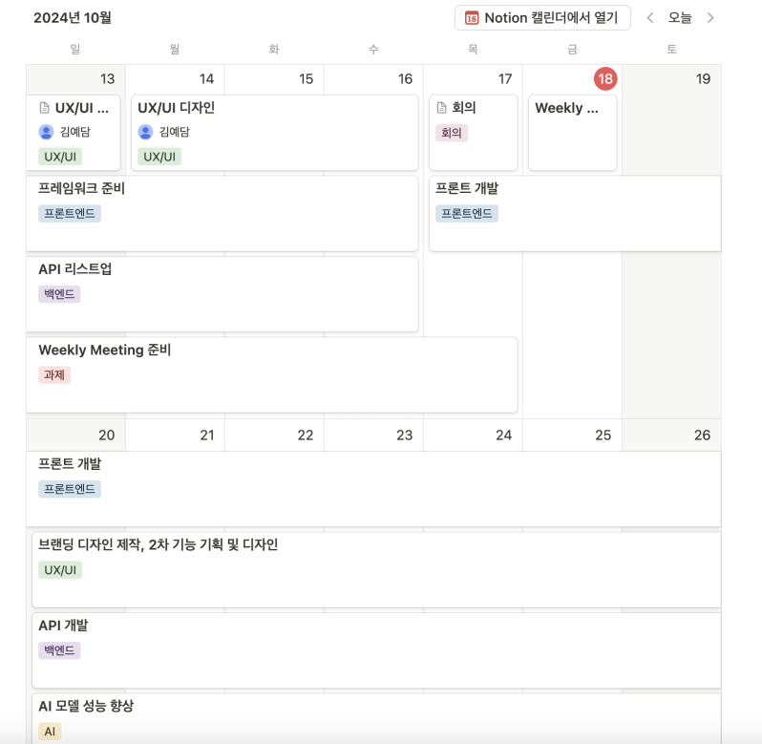
04. Plan
Capstone Design Project

Slide 28



04. Plan
UX/UI Design
Front-end
AI
Specify
Detailed Features and Policy
Fetch to the Back-end
of the entered parameters
Structural modification and Performance improvement
Create a Branding Design
Implementation
of an Unimplemented Pages
Logo CI, Color Chip, Typography
Back-end
Planning Additional Features and Building Wireframes
Implementation
of Detailed Features
Developing API
Capstone Design Project

Slide 29


Q & A
NLP-based Psychological Diagnostic Diary
Capstone Design Project

